Slide 1

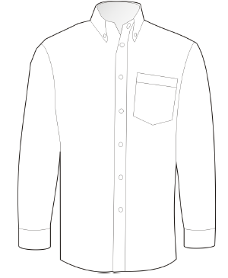
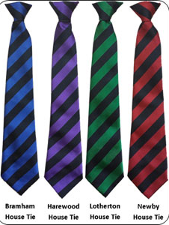
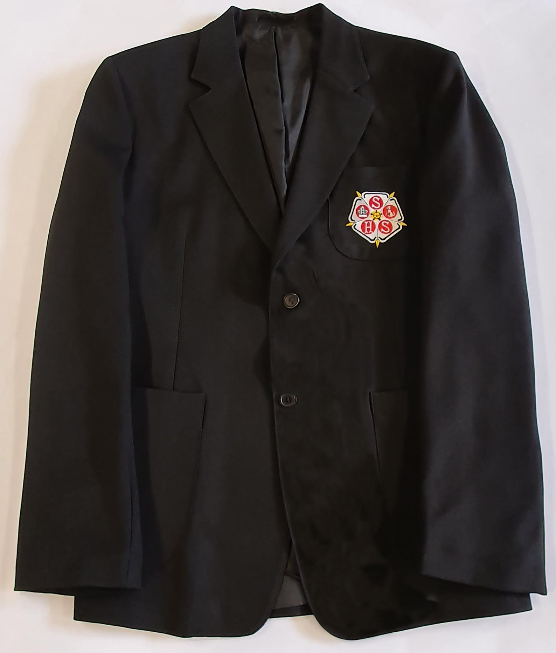
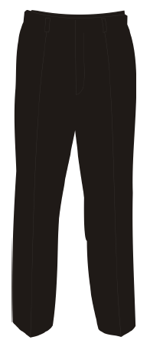
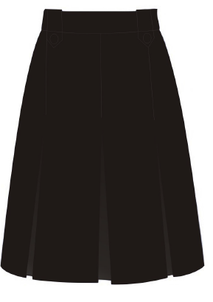
School Uniform
White school shirt (long or short sleeved with top button fastened)
+
House Tie (Striped with House colour)
+
Black Blazer with school badge
Black, traditional style school trousers
or
Black skirt

Slide 2
Uniform Reminders: All students are expected to maintain a high standard of personal appearance. The following is Sherburn High School uniform:
Black Sherburn High School blazer with our name and logo on the breast pocket, sleeves rolled down. Fashion jackets or suit style jackets are not permitted. All students’ blazers must display the SHS badge
Plain white collared shirt, with the top button fastened and tucked in at the waistband
House tie clipped onto the shirt collar
Optional, black 'V' necked jumper (not a PE sweatshirt style)
Trousers: Conventional black school trousers which are tailored. Tailored means not tight fitting or figure hugging and not made from stretchy fabrics. Conventional black school trousers means without fashion zip detailing, rivets on pockets or jean like design.
Skirts: Black knee length skirts which do not have a visible gold/silver zip and are not made of stretchy fabrics
Plain black leather shoes - no boots or trainers allowed. Shoes need to be below the ankle in plain black leather. Shoes should not have brown or other coloured soles even if they are black in the main.
We do not allow canvas shoes, trainers or pumps (whether fabric or leather). Anything with a visible logo is not allowed, and neither are the branded fashion products including those from Vans, Converse, Kickers, Dr. Martens, Nicholas Deakins, Adidas or Stan Smith.

Slide 3
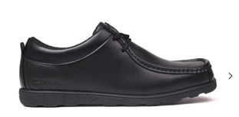
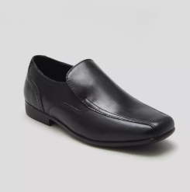
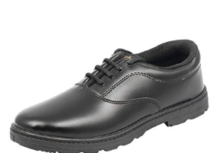
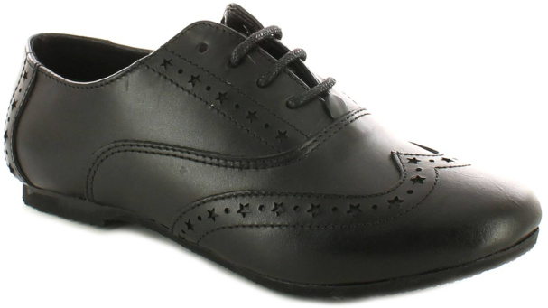
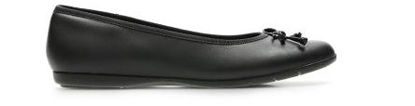
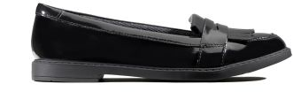
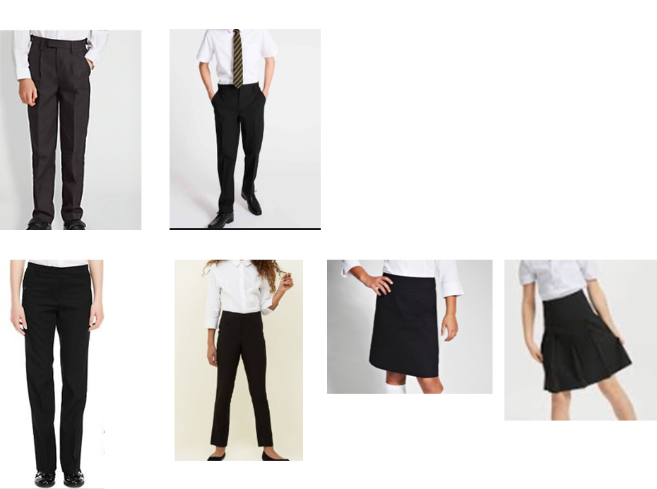
Uniform Guidance
These are examples of acceptable uniform shoes, trousers and skirts.

Slide 4
School Uniform
Outdoor clothing: During periods of inclement weather we encourage students to wear suitable outdoor coats to make sure that they are warm and dry. Outdoor items such as coats, hats and scarves can be worn to and from the school, however, these should be removed before entering the buildings.
Hooded tops: These are not allowed on the school site (aside from the Year 11 hoody for students meeting the set criteria).
Jewellery: Single ear studs worn in each lobe are permitted, however these should be removed for PE lessons. No other piercings are allowed and no other jewellery should be worn. This is for safety reasons.
Make-up: No excessive make-up should be worn. Any student found to be wearing excessive make-up (including nail varnish) will be required to remove it.
Hair colouring: The colouring of parts of the hair so that they are a complete contrast to the other colour is not allowed, e.g. blonde hair with red streaks. Hair colour which is not considered to be natural, or an extreme colour, e.g. reds, blues and purples, is not allowed.
Hairstyles: In addition, lines or patterns cut into a hairstyle, e.g. V cuts are not acceptable (hair should be longer than Grade 1). Students with long hair must ensure that this does not cover their face or provide a health and safety risk. They will be required to tie it back where necessary. Bandana style headbands and excessive hair accessories are not to be worn. Plain hair clips or bands are acceptable.
Please be aware: Breaches in our uniform policy are dealt with in line with our Back to Basics sanction system which is in students’ planners. Students wearing the incorrect uniform will be expected to wear loan uniform for that day and to acquire the correct uniform for the following day. Failure to do so, or refusal to borrow loan uniform will result in sanctions.

Slide 5
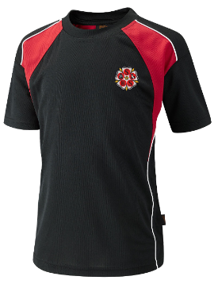
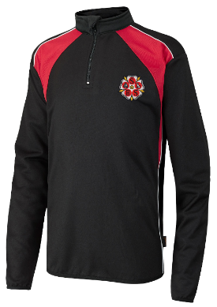
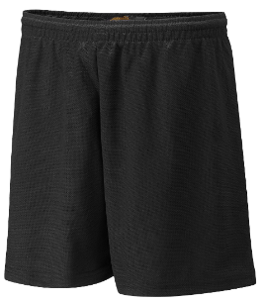
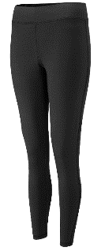
PE Uniform
The School PE kit aims to be practical and smart, balancing the demands of physical exercise with personal comfort and confidence for the students.
PE uniform requirements fall under the oversight of the PE Department and are subject to their assessment of the sports being participated in and the conditions prevalent at the time of year.
Year 7’s PE kit is available from APC clothing.
Round neck sports top - compulsory - Black with red detailing branded round neck sports top. Available via APC clothing.
¼ zip top - optional - Black with red detailing branded ¼ zip top. No other ¼ zip tops will be permitted in PE. Available via APC clothing.
Plain black shorts or leggings - compulsory - no cycling shorts permitted
Plain black tracksuit bottoms - optional - Tracksuit bottoms are optional in cold weather and when on outdoor activities. They must be plain black sports tracksuit bottoms and not leisure/ lounge jogging style bottoms. Tracksuit bottoms should not be worn when on indoor activities.

Slide 6
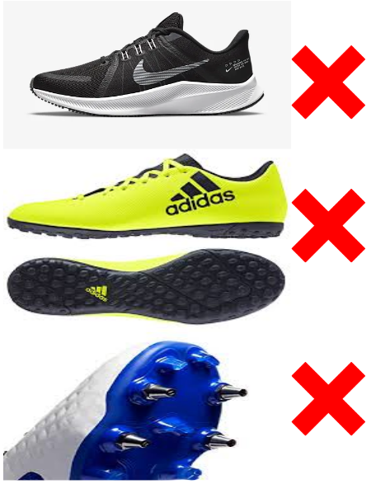
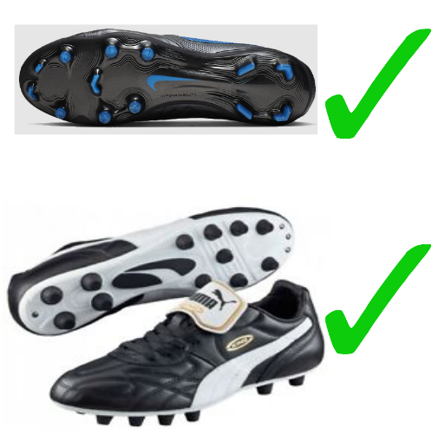
PE Uniform
Trainers - compulsory - Trainers must be suitable for physical activity. Sports style trainer with appropriate grip and support.
Football boots - compulsory - Football boots must be worn on our 3G pitch. Boots must be plastic or rubber studs. No metal studs or astro turf trainers are allowed on our style of artificial surface.
White short socks - compulsory - indoor activity or when not on rugby, football or hockey.
Plain black football socks - compulsory - when on rugby, football or hockey.
Shin pads - compulsory - when on football or hockey.
Towel - optional
Gum shield - recommended for rugby

Slide 7
Expectations of the PE Department
If hair is long it should be tied back for practical lessons.
All students are required to bring the correct kit to their PE lesson even if they have a note to be excused. This will allow excused students to assist in the lesson with tasks such as coaching, officiating, setting up of equipment and assisting the teacher with tasks such as measuring and timing.
If a student refuses to borrow kit, even with a note they will be sanctioned via the school behaviour policy.

Slide 8
Buying Uniform
To make life easier (and cheaper), most of our school uniform can be purchased from clothing shops. For example, black leather shoes, black trousers, white button shirts etc. However, the school blazer needs to be ordered from Better & Bright, Classroom Clothing, APC Clothing or Signature Retail. The only pieces which need to be ordered from school are:
House tie
Reversible rugby shirt (Years 8-11 only)
Sports socks
Summer uniform
NAME | ADDRESS | TEL: | EMAIL | WEBSITE
APC Clothing | Unit 6a Guardian Park Station Road Industrial Estate Tadcaster LS24 9SG | 01937833449 | sales@apc-clothing.co.uk | www.apc-clothing.co.uk
BETTER & BRIGHT | 65 The Market Place Carlton Street CASTLEFORD WF10 1BG | 01977 557196 | info@betterandbrightschoolwear.co.uk | www.betterandbrightschoolwear.co.uk/
CLASSROOM CLOTHING LTD | 25 Finkle Street SELBY YO8 4DS | 01757 700577 07958 614562 | enquiries@classroomclothing.co.uk | www.classroomclothing.co.uk
SIGNATURE RETAIL | 13 Ropergate PONTEFRACT West Yorkshire WF8 1LL | 01977 600324 | signatureschoolwear@gmail.com | www.signatureretail.co.uk
UNIFORM SUPPLIED BY SHERBURN HIGH SCHOOL
House Colour Tie £4.00
Summer Polo Shirts: Reversible Rugby Shirts:
Age 11-13 (32” Chest) Size Extra Small (34” Chest) £8.40 30”-32” and 33” Chest £15.50
Size Small (36” Chest) Medium (38” Chest) £9.60 36”-38” Chest £18.00
Size Large (40” Chest) Extra Large (42” Chest) £9.60 40”-42” Chest £18.00
42”-44” Chest £18.00
Red Sports Socks (Size1-6/6-12) £4.00

Slide 9
Mobile Phones
The school strongly advises that mobile phones should not be brought into school at all. Students have no legitimate need to use a mobile phone in the school day. Please familiarise yourself with our Mobile Phone Policy on the policy page of our website which clearly outlines the school’s expectations and sanctions if the policy is breached.
The purpose of this policy is to prevent the unacceptable use of mobile phones, camera phones, MP3 players and Apple watches (or equivalent) impacting negatively on learning and from preventing staff from concentrating on students’ learning experiences.

