Slide 1

Sherburn High School
Year 6 into 7
‘The Sherburn Essentials’

Slide 2
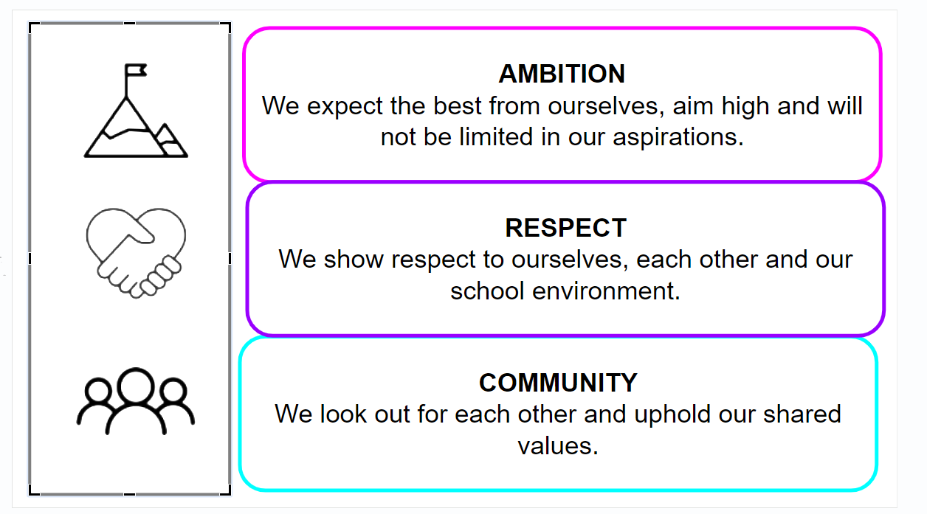
Sherburn High
School Values
Being part of Team Sherburn means we encourage the following values in our students:
Ambition
Respect
Community

Slide 3

Introduction
Welcome to Team Sherburn!
Introduction
Welcome to Team Sherburn! We hope our guide will provide you with information and advice to support your child as they move from primary to secondary school. Our aim is to make the transition process as smooth and stress-free as it can be. If you have any queries, please do not hesitate to get in touch: transition@shs.starmat.uk
Term Dates and Holidays
Link to School Calendar
 | First Day Closed | First Day Open
Autumn Term |  | Tuesday 2nd September for Y7
Half Term | Monday 27th October | Monday 3rd November
Christmas | Monday 22nd December | Monday 5th January
Half Term | Monday 16th February | Monday 20th February
Easter | Monday 30th March | Monday 13th April
Half Term | Monday 25th May | Monday 1st June
Summer | Monday 20th July
Training Days:
Friday 24th October 2025
Friday 28th November 2025
Monday 5th January 2026
Wednesday 24th June 2026
Monday 20th July 2026

Slide 4
Useful Contact Information
The easiest way to contact the school is via email or telephone. If your query is general, you will need to get in touch with the school office. If your query is relating to lessons, you should get in touch with your child’s subject teacher. If it is an emotional/social issue to do with your child, you should speak to your child’s form tutor (for basic issues) or your child’s Year Leader (for more serious issues).
You are welcome to request a meeting with any member of staff, but we please ask that you either ring or email first to arrange an appointment.
Key Staff for Year 7
Contact Details:
Sherburn High School
Garden Lane
Sherburn in Elmet
Leeds
LS25 6AS
Tel: 01977 682442
admin@shs.starmat.uk
www.sherburnhigh.co.uk
Ms R Marsh | Transition Lead | transition@shs.starmat.uk
Ms S Wilmot | SENDCO | sarah.wilmot@shs.starmat.uk
Mrs C Atkinson | Inclusion Leader | carroll.atkinson@shs.starmat.uk

Slide 5
Curriculum Area Contact Information
English | Mr C McAshton | callum.mcashton@shs.starmat.uk
Mathematics | Miss L Beardsworth | laura.beardsworth@shs.starmat.uk
Science | Mr C Hampton | chris.hampton@shs.starmat.uk
Creative | Mrs L Jamieson | leah.jamieson@shs.starmat.uk
Drama | Mrs N Caldwell | natalie.caldwell@shs.starmat.uk
Geography | Mrs J Goulding | jodie.goulding@shs.starmat.uk
Health and Social Care | Miss C Dodd | charlotte.dodd@shs.starmat.uk
History | Mrs N Kesterton | natalie.kesterton@shs.starmat.uk
ICT and Business Studies | Mrs V Taylor | victoria.taylor@shs.starmat.uk
MFL | Mrs H Kibble | hayley.kibble@shs.starmat.uk
Music | Miss C Connell | claire.connell@shs.starmat.uk
Physical Education | Mr L Stubbins | luke.stubbins@shs.starmat.uk
Religious Education | Mr A Easton | alex.easton@shs.starmat.uk

Slide 6
School Uniform
Please refer the School Uniform page here
The School Planner
Regular checks are made to see that all students are using planners correctly. The planner is an excellent means of communication between home and school. A planner which is poorly kept, has graffiti in it and has a lack of information in it – such as no homework, is an indication of a student who is underachieving and would be of concern to us and no doubt of concern to parents/carers. Students who graffiti their planner will be expected to purchase a new one.
Ready to Learn: Equipment
Students will need the following equipment:
2 blue/black pens
1 pencil
A ruler
An eraser
A yellow highlighter pen
A red pen
A packet of pencils
A glue stick
A blue or black whiteboard pen
A scientific calculator (Casio Classwiz, fx-85GTX)
A reading book
A water bottle
Please ensure that students school bags are large enough to carry their equipment and exercise books (which are predominately A4 in size)
School Equipment

Slide 7
Rewards
At Sherburn High School we believe that students learn by praise, reward and celebration of achievement. The list below illustrates the various rewards that are given out in school:
1. Verbal and non-verbal praise by staff.
2. Positive letters home / Postcards / E-mails
3. Achievement points on Class Charts
4. Public recognition of achievement: assembly, newsletters, annual Celebration Evenings,
5. Group achievement recognition: Inter-house trophies and other competitions.
6. Individual effort recognition leading to Reward Prizes.
7.. Form groups will be rewarded for behaviour and attendance.
​8. Termly certificates awarded in assemblies.
9. Reward breakfasts
10.Friday Super 6 slips are awarded by staff for meeting the school ethos
The Senior Leadership Team collects these slips during Friday lesson 6 and gives out rewards. A further 6 student names are picked out of the Super 6 Lucky Dip and these students receive additional rewards in registration time the following week.
Behaviour Policy
Please refer the Behaviour Policy on our policy page here

Slide 8
Home School Agreement
During the time students are with us at Sherburn High we believe that it is very important that a spirit of trust and co-operation is built up between teachers, parents and young people. This agreement sets out some of the specific ways in which we can all play our part to achieve this positive atmosphere expressing the willingness of all concerned to work together for the benefit of all young people in the school.
The school will
provide a caring, supportive environment in which each individual is valued
provide a full and balanced curriculum which, as far as is possible, educates each student to the best of his/her ability
provide information about each child’s educational progress as well as the child’s development in other areas of school life.
arrange meetings with each child’s teachers and be available at other times when concerns or questions arise, keeping parents informed about problem areas.
refer vulnerable students to external agencies with parental/student consent. Agencies can offer advice and information to young people without the consent of a parent but will always aim to involve parents where possible.
Parents will
ensure that their child attends school regularly and punctually, avoiding holidays during term time and providing school with a note to cover any absence
arrange any appointments out of school hours
support and work with the school and encourage a positive attitude to education
support the discipline procedures of the school
support the school ethos of homework, discussing it with their child when signing the student planner each week
ensure that their child meets school requirements regarding uniform and general appearance and has appropriate equipment for each day
let the school know of any concerns about their child’s education, attend meetings at school to discuss progress and to learn about the work of the school, inform school of any factors which may affect their child’s performance in school
ensure that their child attends any after school detentions that are issued and can get home safely
support School Policies, e.g. Behaviour Policy

